Slide 1
Hardware Software Project Presentation
Temperature display on a webserver
1st year of Master
Giambarresi Luca
Niyonzima Jostein
luca.giambarresi@student.umons.ac.be
jostein.niyonzima@student.umons.ac.be
Umons : https://web.umons.ac.be/fr/

Slide 2
Objectives
To use chips (Arduino Uno, ESP8266) with integrated micro controllers
To create an existing project
To add a modification to improve the original tutorial
To put in practice what has been learnt during the Microprocessors course (3rd year Bachelor)

Slide 3
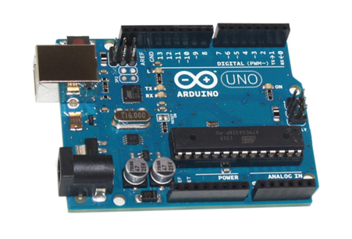
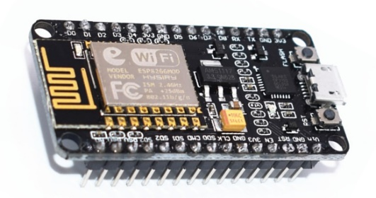
Problem Definition
Temperature measurement on Arduino Uno
Webserver configuration of an ESP8266
Communication between
&

Slide 4
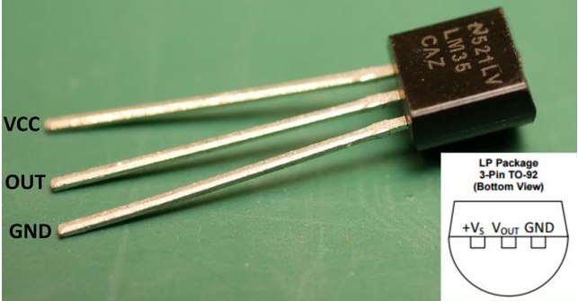
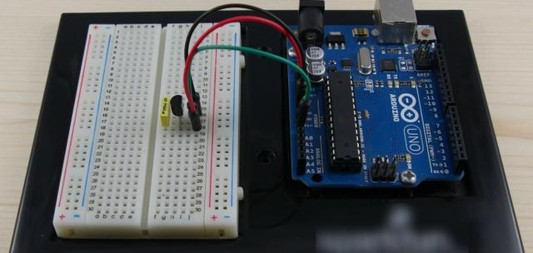
Original tutorials
Temperature measurement with Arduino Uno
Material :
Temperature sensor LM35
1 Breadboard
3 wires
1 Arduino Uno with USB cable
Computer

Slide 5
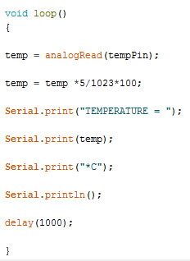
Original tutorials
Temperature measurement with Arduino Uno
Steps :
5 V = 1023
10 mV = 1°C

Slide 6
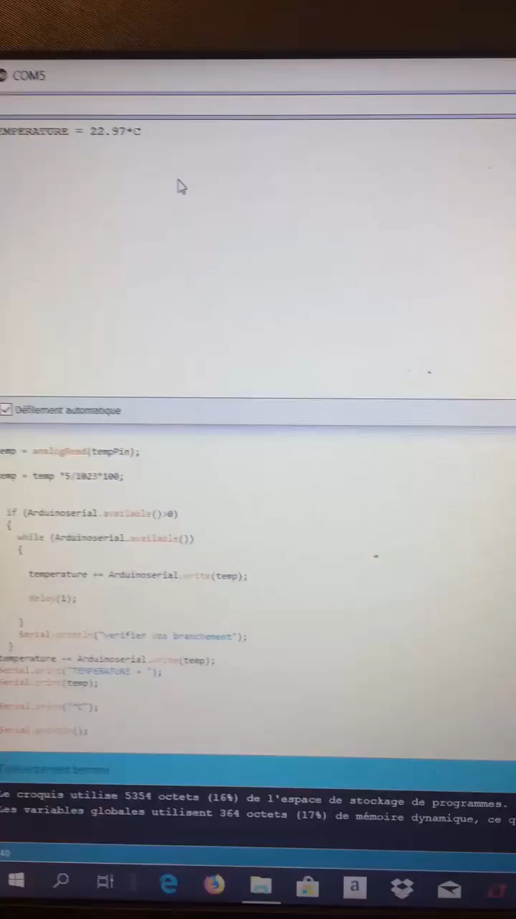
Results

Slide 7
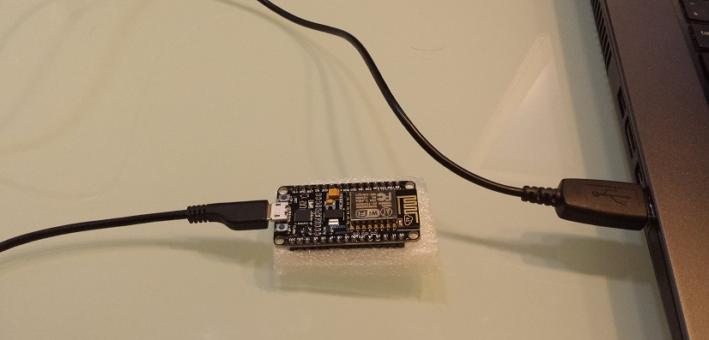
Original tutorials
ESP8266 working as a webserver
Material :
1 ESP8266 with USB cable
1 Computer

Slide 8
Original tutorials
ESP8266 working as a webserver
Goal : program the ESP8266 to behave like a webserver. We can interact from a web interface accessible from a web browser.

Slide 9
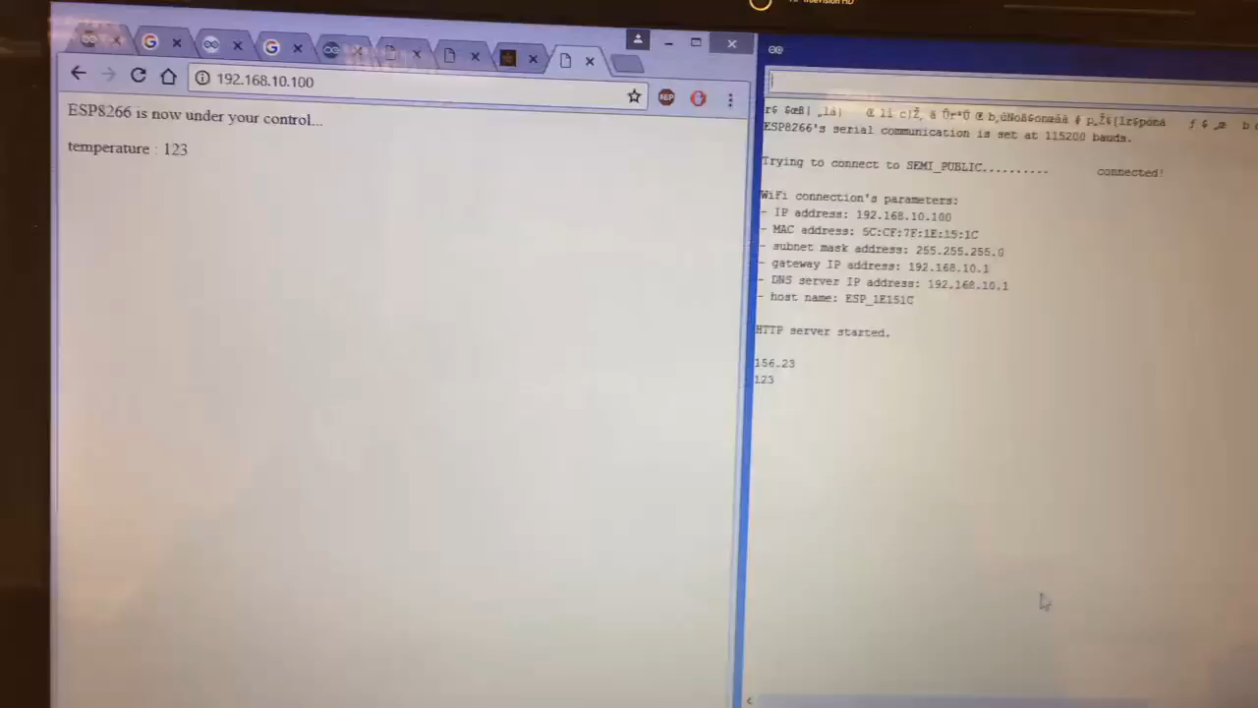
Results

Slide 10
From Arduino to ESP8266
Serial
Issue
Solution
Problem
Comparison
Notes:
Usally what we can do with an Arduino for this kind of project is to collect voltage or data and send them to an other device
For this particular project as explained before, we collect the voltage from the set up and transfer the data link to this voltage measurement directly to the ESP with the help of the Arduino.
But how does it work ?
For you to have a better comprehension of how we used the Arduino Uno and what is going on we will explain some basic concept

Slide 11
Serial
Hardware
Crossover between RX-TX
Software
Simplex
Half-duplex
Full-duplex
Notes:
Now that we know how the data will be send we have to look about the how we will put the data transfer in place.
For the wiring we choose to work with the RX-TX connexion blabla
For the Hardware it’s essential to know which implementation we will use whether it is for the Arduino or for the ESP8266.
Here we are looking at the implementation at the signal level
There is essentially 2 kind of implementation : TTL (transistor-transistor-level): VCC=1, idle line or stop bit and Ground=0 ( data bit value) or start bit
and RS-232: lower voltage (-13V) =idle line, data bit of value 1, stop bit. Ground = start bit or bit of value 0,
For the Arduino it’s the TTL that prevails but for the ESP when we are using it’s wifi module it’s the RS-232 that prevails

Slide 12
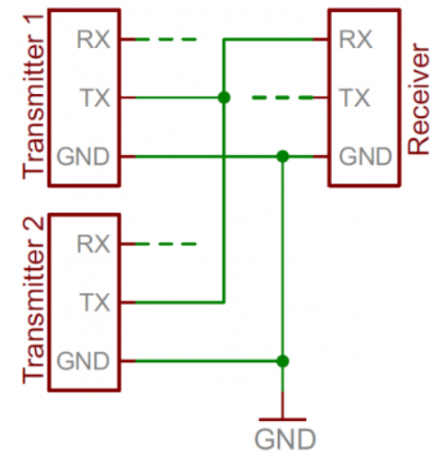
Issue
bus contention
computer
ESP8266
Arduino
Notes:
Serial communication is designed to allow just two devices to communicate across one serial bus. If more than one device is trying to transmit on the same serial line you could run into bus-contention. Dun dun dun….
For example, if you’re connecting a GPS module up to your Arduino, you may just wire that module’s TX line up the Arduino’s RX line. But that Arduino RX pin is already wired up to the TX pin of the USB-to-serial converter, which is used whenever you program the Arduino or use the Serial Monitor. This sets up the potential situation where both the GPS module and FTDI chip are trying to transmit on the same line at the same time.
It can be safe to connect multiple receiving devices to a single transmitting device. Even if it’s not really recommended it will work

Slide 13


Solution
SoftwareSerial
It’s usually used when there is not enough TX-RX
Allow some specific pins to act as TX-RX
Can not simultaneously transmit and receive data

Slide 14
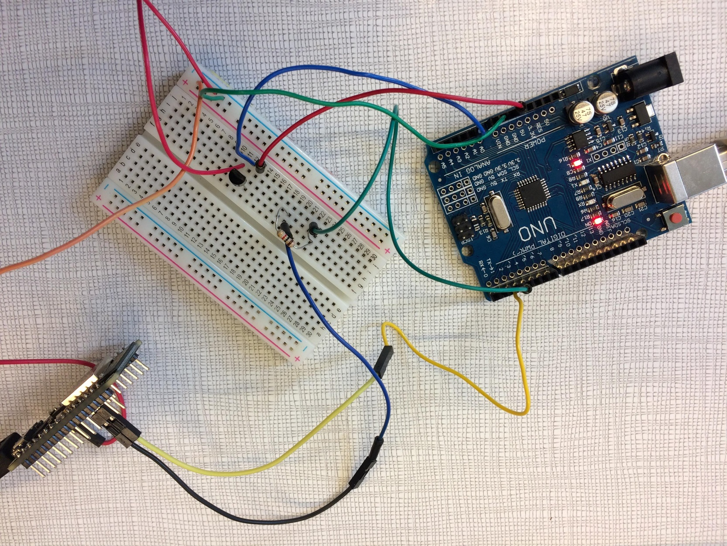
Breadboard set-up

Slide 15
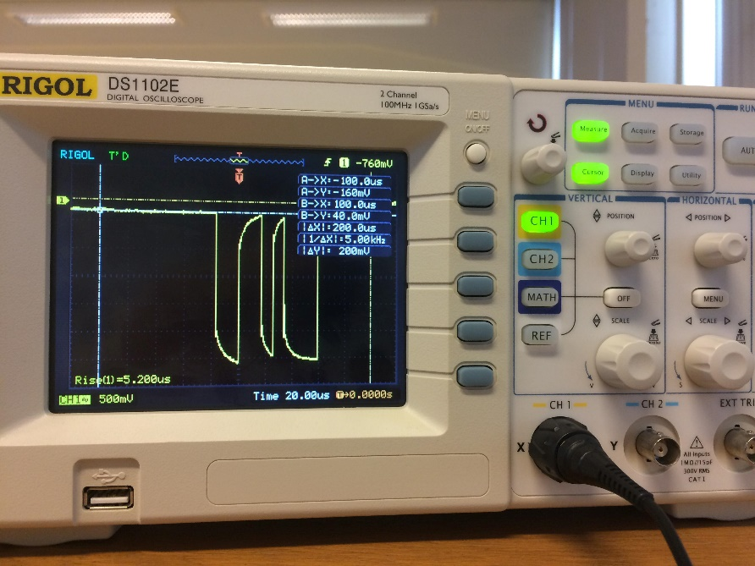
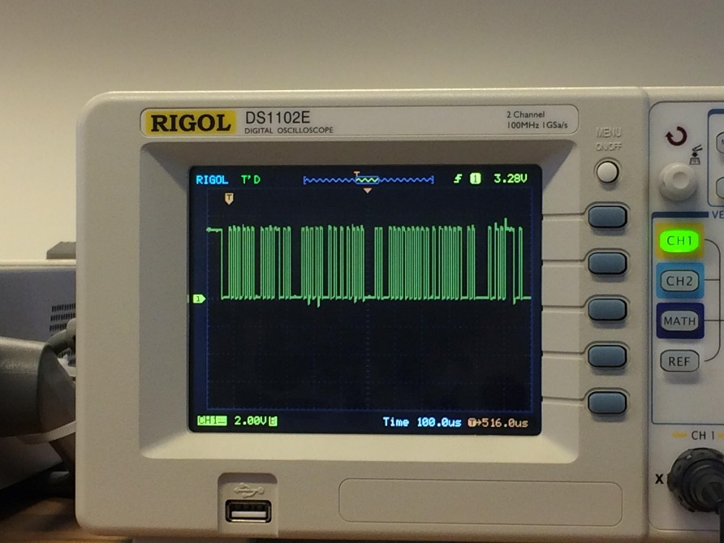
Problem
TX-RX instead of SoftwareSerial
SoftwareSerial pin
TX pin

Slide 16


Comparison
Temperature measurement
Webpage creation + display of serial monitor content
Sending the temperatures from Arduino Uno
to ESP8266 + display
The SoftwareSerial solution
The "ping-pong" code test
GitHub link : https://github.com/j-niyosz/Temperature-display-on-a-webserver

Slide 17

Conclusion
Thank you for your attention !
Questions ?

Slide 18
Annexe

Slide 19
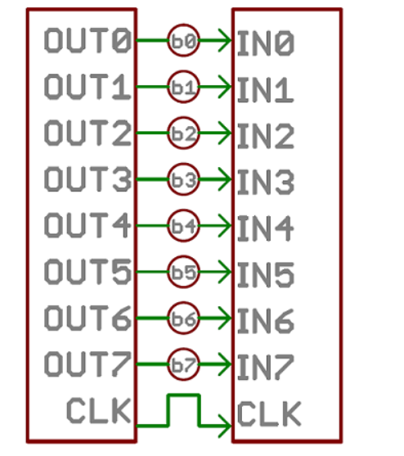
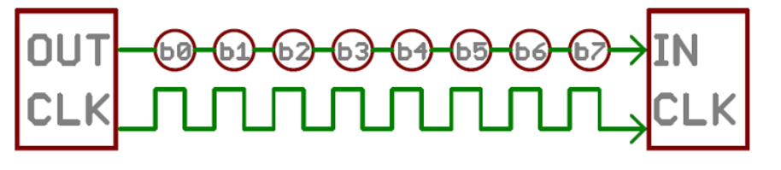
Serial vs Parallel
Parallel : transfer multiple bits at the same time
Serial : stream the data one bit at the time
Notes:
First of all, we have to know that data can be send through 2 types of interface stream : the Parallel and the Serial stream.
The parallel use a multiple transfer bits at the same time and the serial stream use a single bit transfer which correspnd to 1 bit at the time.
For this project we will essentially focus our transmission on the serial stream.
Even if the parallel stream offer a faster transfer the serial stream is more suitable for the application we are looking for

Slide 20
Serial
Serial
Synchronous and asynchronous
Synchronous : faster transmission but requires supplement wire for the clock (ex : SPI, I²C)
Asynchronous : less fast but perfect for minimizing the number of wires and I/O pins.
Data chunk
The information is transmitted by frame of bits at a certain speed called baud rate (bits/sec)
Notes:
Now that we know that we will use the serial transmission we have to discuss about the way we want to send the data.
Indeed we can send the data via an asynchronous or a synchronous serial interface with each of these methods has its cons and pros.
Slide …but by choosing a good baud rate and for the final goal of the project we don’t specially need a fast transmission. More over
To simplify the wiring we choose to opt for an asynchronous serial transmission.

Slide 21
Serial
Wiring
Crossover between RX-TX
Software
Simplex
Half-duplex
Full-duplex
Hardware implementation
TTL
RS-232
Notes:
Now that we know how the data will be send we have to look about the how we will put the data transfer in place.
For the wiring we choose to work with the RX-TX connexion blabla
For the Hardware it’s essential to know which implementation we will use whether it is for the Arduino or for the ESP8266.
Here we are looking at the implementation at the signal level
There is essentially 2 kind of implementation : TTL (transistor-transistor-level): VCC=1, idle line or stop bit and Ground=0 ( data bit value) or start bit
and RS-232: lower voltage (-13V) =idle line, data bit of value 1, stop bit. Ground = start bit or bit of value 0,
For the Arduino it’s the TTL that prevails but for the ESP when we are using it’s wifi module it’s the RS-232 that prevails

Slide 22
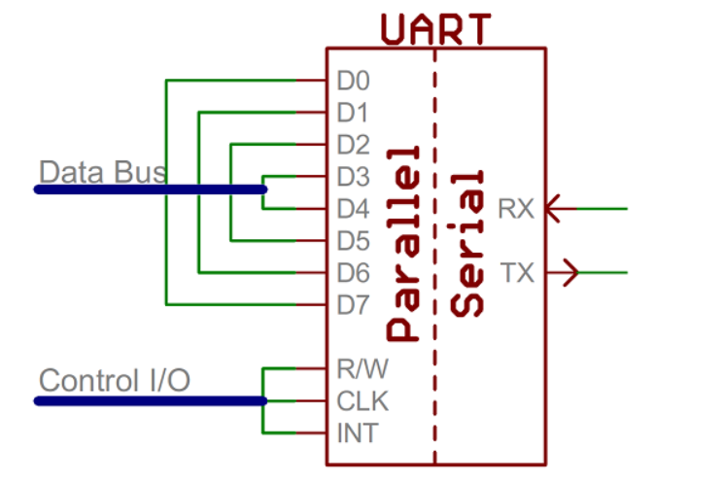
Serial
Software : UART
Notes:
UART = universal asynchronous receiver/transmiter
is a block of circuitry responsible for implementing serial communication. Essentially, the UART acts as an intermediary between parallel and serial interfaces. On one end of the UART is a bus of eight-or-so data lines (plus some control pins), on the other is the two serial wires - RX and TX.
On the transmit side, a UART must create the data packet - appending sync and parity bits - and send that packet out the TX line with precise timing (according to the set baud rate). On the receive end, the UART has to sample the RX line at rates according to the expected baud rate, pick out the sync bits, and spit out the data.

Slide 23
Solution
SoftwareSerial
It’s usually used when there is no UART at all or not enough UART. In other words : not enough TX-RX
Allow some specific pins to act as TX-RX
Can not simultaneously transmit and receive data
Sensitive to interrupt usage by other libraries

